Slide 1
Project Presentation on Loan Approval Prediction Using ML
Department of Computer Science & Engineering
MMMUT Gorakhpur, (UP), India
Presented by: Project Guide :
Vishal Singh (2020022015) Prof. A.K. Sharma
Priya Pal (2019021110)
Rati Sonkar (2019021115)

Slide 2
Content
Introduction
Motivation
Objective
Problem Statement
Steps involved
Datasets, Features & Labels
Visualizing data using Google Colab
Model to predict Loan Status
Logistic regression
K nearest neighbors
Decision tree
Random forest
Support vector machines
Naïve Bayes classifier
Future Scope
Conclusion
Bibliography

Slide 3
INTRODUCTION
Loans are the core business of banks. The main profit comes directly from the loan’s interest. The loan companies grant a loan after an intensive process of verification and validation. However, they still don’t have assurance if the applicant is able to repay the loan with no difficulties.
Machine learning algorithms can exploit this dependency on past experiences and comparisons with other applicants and formulate a model to predict the loan status of a new applicant using similar rules.

Slide 4
Motivation
Machine Learning has become increasingly popular tool in almost every industry out there be it Smartphone Industry, Healthcare or Banks. With Machine Learning we can achieve so much. We will be using machine learning algorithms along with some data analysis techniques in our project.

Slide 5
Objective
Our project focus is to use existing customer’s details and analyze it further by applying a few machine learning techniques and predict which future applicant can be approved the loan.

Slide 6
Problem Statement
It is a classification problem where we have to predict whether a loan would be approved or not. In a classification problem, we have to predict discrete values based on a given set of independent variables.
Classification can be of two types:
Binary Classification : In this classification we have to predict either of the two given classes. For example: classifying the gender as male or female, predicting the result as win or loss, etc.
Multiclass Classification : Here we have to classify the data into three or more classes. For example: classifying a movie's genre as comedy, action or romantic, classify fruits as oranges, apples, or pears, etc.
Loan prediction is a very common real-life problem that each retail bank faces in its lifetime. If done correctly, it can save a lot of man hours at the end of a retail bank.

Slide 7
Steps involved in machine learning
1 - Data Collection
The quantity & quality of your data dictate how accurate our model is
The outcome of this step is generally a representation of data (Guo simplifies to specifying a table) which we will use for training
Using pre-collected data, by way of datasets from Kaggle, UCI, etc., still fits into this step
2 - Data Preparation
Wrangle data and prepare it for training
Clean that which may require it (remove duplicates, correct errors, deal with missing values, normalization, data type conversions, etc.)
Randomize data, which erases the effects of the particular order in which we collected and/or otherwise prepared our data.

Slide 8
Steps involved in machine learning
3 - Choose a Model
Different algorithms are for different tasks;
4 - Train the Model
The goal of training is to answer a question or make a prediction correctly as often as possible
Each iteration of process is a training step

Slide 9
Steps involved in machine learning
5 - Evaluate the Model
Uses some metric or combination of metrics to measure objective performance of model
Test the model against previously unseen data
This unseen data is meant to be somewhat representative of model performance in the real world, but still helps tune the model (as opposed to test data, which does not)
Good train/evaluate split 80/20, 70/30, or similar, depending on domain, data availability, dataset particulars, etc.

Slide 10
Steps involved in machine learning
6 - Parameter Tuning
This step refers to hyper-parameter tuning, which is an art form as opposed to a science
Tune model parameters for improved performance
Simple model hyper-parameters may include: number of training steps, learning rate, initialization values and distribution, etc.
7 - Make Predictions
Using further (test set) data which have, until this point, been withheld from the model, are used to test the model; a better approximation of how the model will perform in the real world.

Slide 11
DATASETS
Here we have two datasets. First is train_dataset.csv, test_dataset.csv.
These are datasets of loan approval applications which are featured with annual income, married or not, dependents are there or not, educated or not, credit history present or not, loan amount etc.
The outcome of the dataset is represented by loan status in the train dataset.
This column is absent in test_dataset.csv as we need to assign loan status with the help of training dataset.

Slide 12
FEATURES PRESENT IN LOAN PREDICTION
Loan_ID – The ID number generated by the bank which is giving loan.
Gender – Whether the person taking loan is male or female.
Married – Whether the person is married or unmarried.
Dependents – Family members who stay with the person.
Education – Educational qualification of the person taking loan.
Self_Employed – Whether the person is self-employed or not.
ApplicantIncome – The basic salary or income of the applicant per month.
CoapplicantIncome – The basic income or family members.
LoanAmount – The amount of loan for which loan is applied.
Loan_Amount_Term – How much time does the loan applicant take to pay the loan.
Credit_History – Whether the loan applicant has taken loan previously from same bank.
Property_Area – This is about the area where the person stays ( Rural/Urban).

Slide 13
Labels
LOAN_STATUS – Based on the mentioned features, the machine learning algorithm decides whether the person should be give loan or not.

Slide 14
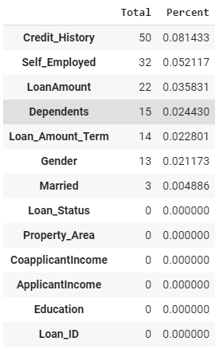
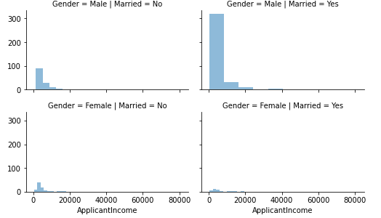
Visualizing data using Google Colab

Slide 15
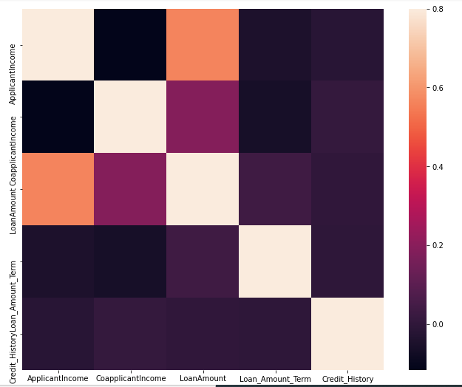
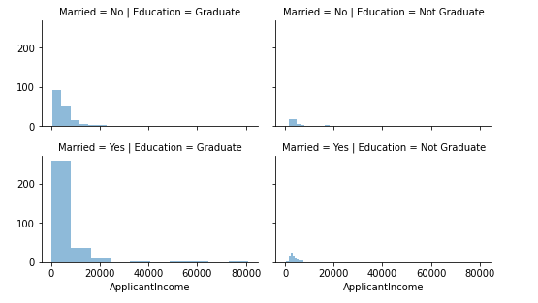
Visualizing data using google Colab

Slide 16
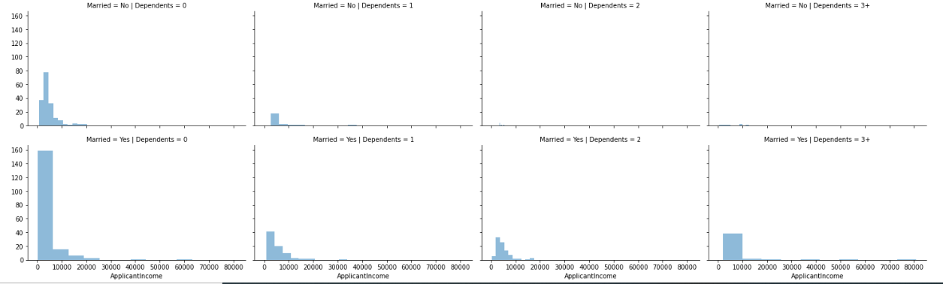
Visualizing data using Google Colab

Slide 17
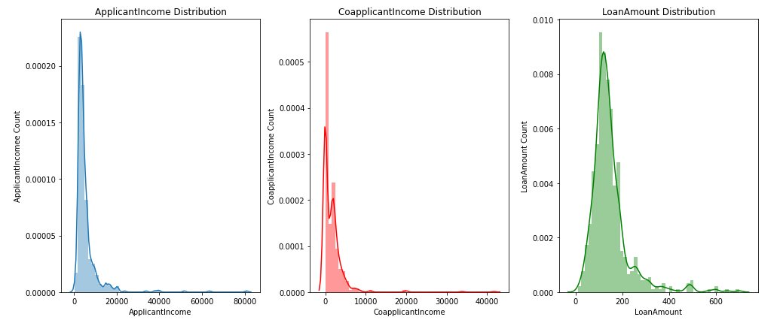
Visualizing data using google Colab

Slide 18
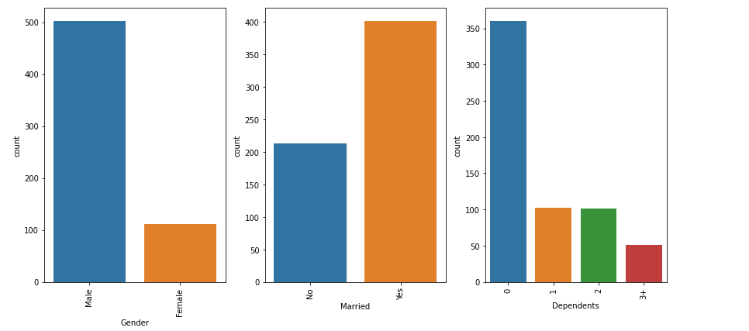
Visualizing data using google Colab

Slide 19
Methods to predict Loan Status
Loan prediction using logistic regression
Loan prediction using K nearest neighbors
Loan prediction using decision tree classification
Loan prediction using random forest classification
Loan prediction using support vector machines
Loan prediction using Naïve Bayes classifier

Slide 20

Logistic Regression
Logistic regression estimates the probability of an event occurring, such as voted or didn’t vote, based on a given dataset of independent variables. Since the outcome is a probability, the dependent variable is bounded between 0 and 1.
Logistic regression is used for solving the classification problems.
The equation for logistic regression

Slide 21
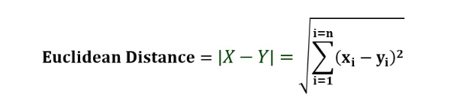
K Nearest Neighbours
K Nearest Neighbours (KNN) is a supervised machine learning algorithm used for classification and regression. The algorithm stores all the training data points and uses them to classify new data points based on their similarity to the existing data points.
The algorithm works as follows:
For a given new data point, find the k nearest neighbors in the training data based on their Euclidean distance or some other distance metric.
Assign the new data point to the class that appears most frequently among its k nearest neighbors (for classification tasks) or take the average of the k nearest neighbors' target values (for regression tasks).

Slide 22
Decision Trees
Decision tree is a type of supervised learning algorithm that is mostly used in classification problems. In this technique, we split the population or sample into two or more homogeneous sets based on most significant differentiator in input variables.
Decision trees use multiple algorithms to decide to split a node in two or more sub-nodes. The creation of sub-nodes increases the homogeneity of resultant sub-nodes. In other words, we can say that purity of the node increases with respect to the target variable.

Slide 23
Random Forest
Random Forest is a tree based bootstrapping algorithm wherein a certain number of decision trees are combined to make a powerful prediction model.
For every individual tree, a random sample of rows and a few randomly chosen variables are used to build a decision tree model.

Slide 24
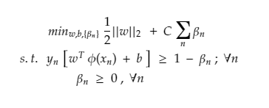
Support Vector Machines
Support Vector Machines (SVMs) are a popular type of supervised learning algorithm that can be used for both classification and regression tasks. The basic idea of SVMs is to find the hyperplane that maximally separates the data points of different classes in the feature space.
The decision boundary of a SVM can be expressed as a linear combination of the training data points, where each data point is assigned a weight called the support vector coefficient. The decision boundary can then be used to classify new data points based on which side of the hyperplane they fall on.

Slide 25
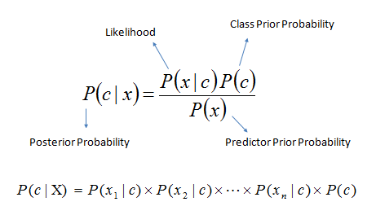
Naïve Bayes Classifier
Naïve Bayes Classifier is a probabilistic machine learning algorithm based on Bayes' theorem with the assumption of independence between the features. It is a simple and efficient algorithm that works well on high-dimensional datasets with a large number of features.
The basic idea behind Naïve Bayes is to compute the posterior probability of each class given the input features and then choose the class with the highest probability.

Slide 26
Future scope
Future analysis can be done on predicting the approximate interest rates that the loan applicant is expected to be charged as per his profile, if his loan is approved .This can be useful for loan applicants, since some banks approve loans, but give very high interest rates to the customer.
An app with proper UI can be built ,which will take various inputs from the user like name ,address , loan amount , loan duration , etc. and give a prediction of whether their loan application can be approved by the banks or not based on their inputs along with an approximate interest rates.

Slide 27
Conclusion
Loan companies grant loans after a through verification and validation process. However, they do not know with absolute certainty whether the applicant will be able to repay the loan without difficulty.
The loan Prediction System will allow them to choose the most deserving applicants quickly, easily, and efficiently. It may provide the bank with unique benefits.
In this presentation, we have reviewed the process of building a Loan Approval Prediction System. Data collection, Exploratory Data Analysis, Data Preprocessing , Model Building, and Model Testing are the analytical processes involved in building this system.

Slide 28
Bibliography
www.kdnuggets.com
www.analyticsvidhya.com
www.machinelearningmastery.com
https://www.ibm.com/in-en/topics/logistic-regression#:~:text=Logistic%20regression%20estimates%20the%20probability,bounded%20between%200%20and%201
https://www.analyticsvidhya.com/blog/2021/04/exploratory-analysis-using-univariate-bivariate-and-multivariate-analysis-techniques/
https://medium.com/analytics-vidhya/univariate-bivariate-and-multivariate-analysis-8b4fc3d8202c#:~:text=Univariate%20analysis%20looks%20at%20one,two%20variables%20and%20their%20relationship

Slide 29
THANK YOU

